Slide 1
CSE 6406: BIOINFORMATICS ALGORITHMS
CSE 463: INTRODUCTION TO BIOINFORMATICS
combinatorial pattern matching

Slide 2
Outline
Repeat Finding
Hash Tables
Exact Pattern Matching
Keyword Trees
Suffix Trees
Suffix Array
Burrows-Wheeler Transform (BWT)
FM Index

Slide 3
Genomic Repeats
Example of repeats:
  ATGGTCTAGGTCCTAGTGGTC
Motivation to find them:
  Genomic rearrangements are often associated with repeats
  Trace evolutionary secrets
  Many tumors are characterized by an explosion of repeats

Slide 4
Genomic Repeats
The problem is often more difficult:
  ATGGTCTAGGACCTAGTGTTC
Motivation to find them:
  Genomic rearrangements are often associated with repeats
  Trace evolutionary secrets
  Many tumors are characterized by an explosion of repeats

Slide 5
l-mer Repeats
Long repeats are difficult to find
Short repeats are easy to find (e.g., hashing)
Simple approach to finding long repeats:
  Find exact repeats of short l-mers (l is usually 10 to 13)
  Use l-mer repeats to potentially extend into longer, maximal repeats

Slide 6
l-mer Repeats (cont’d)
There are typically many locations where an l-mer is repeated:
GCTTACAGATTCAGTCTTACAGATGGT
The 4-mer TTAC starts at locations 3 and 17

Slide 7
Extending l-mer Repeats
GCTTACAGATTCAGTCTTACAGATGGT
Extend these 4-mer matches:
GCTTACAGATTCAGTCTTACAGATGGT
Maximal repeat: TTACAGAT

Slide 8
Maximal Repeats
To find maximal repeats in this way, we need ALL start locations of all l-mers in the genome
Hashing lets us find repeats quickly in this manner

Slide 9
Hashing: What is it?
What does hashing do?
  For different data, generate a unique integer
  Store data in an array at the unique integer index generated from the data
Hashing is a very efficient way to store and retrieve data

Slide 10
Hashing: Definitions
Hash table: array used in hashing
Records: data stored in a hash table
Keys: identifies sets of records
Hash function: uses a key to generate an index to insert at in hash table
Collision: when more than one record is mapped to the same index in the hash table

Slide 11
Hashing DNA sequences
  Each l-mer can be translated into a binary string (A, T, C, G can be represented as 00, 01, 10, 11)
  After assigning a unique integer per l-mer it is easy to get all start locations of each l-mer in a genome

Slide 12
Hashing: Maximal Repeats
To find repeats in a genome:
  For all l-mers in the genome, note the start position and the sequence
  Generate a hash table index for each unique l-mer sequence
  In each index of the hash table, store all genome start locations of the l-mer which generated that index
  Extend l-mer repeats to maximal repeats

Slide 13
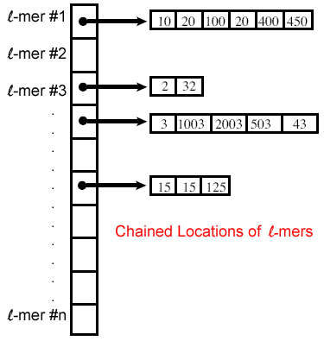
Hashing: Collisions
Dealing with collisions:
  “Chain” all start locations of l-mers (linked list)

Slide 14
Hashing: Summary
When finding genomic repeats from l-mers:
  Generate a hash table index for each l-mer sequence
  In each index, store all genome start locations of the l-mer which generated that index
  Extend l-mer repeats to maximal repeats

Slide 15
Exact pattern matching
Given a pattern (read) and a text (genome), find all positions in the text that matches the pattern?
This leads us to the Pattern Matching Problem.

Slide 16
Pattern Matching Problem
Goal: Find all occurrences of a pattern in a text.
Input:
  Pattern p = p₁…p_{m} of length m
  Text t = t₁…t_{n} of length n
Output: All positions 1< i < (n – m + 1) such that the m-letter substring of text t starting at i matches the pattern p.

Slide 17
Exact Pattern Matching: Brute Force
PatternMatching(p,t)
      m ← length of pattern p
      n ← length of text t
      for i ← 1 to (n – m + 1)
      if t_{i}…t_{i+m-1} = p
      output i

Slide 18
Exact Pattern Matching: An Example
PatternMatching algorithm for:
  Pattern GCAT
  Text AGCCGCATCT

Slide 19
Exact Pattern Matching: An Example
PatternMatching algorithm for:
  Pattern GCAT
  Text AGCCGCATCT
AGCCGCATCT
GCAT

Slide 20
Exact Pattern Matching: An Example
PatternMatching algorithm for:
  Pattern GCAT
  Text AGCCGCATCT
AGCCGCATCT
GCAT

Slide 21
Exact Pattern Matching: An Example
PatternMatching algorithm for:
  Pattern GCAT
  Text AGCCGCATCT
AGCCGCATCT
GCAT

Slide 22
Exact Pattern Matching: An Example
PatternMatching algorithm for:
  Pattern GCAT
  Text AGCCGCATCT
AGCCGCATCT
GCAT

Slide 23
Exact Pattern Matching: An Example
PatternMatching algorithm for:
  Pattern GCAT
  Text AGCCGCATCT
AGCCGCATCT
GCAT

Slide 24
Exact Pattern Matching: An Example
PatternMatching algorithm for:
  Pattern GCAT
  Text AGCCGCATCT
AGCCGCATCT
GCAT

Slide 25
Exact Pattern Matching: An Example
PatternMatching algorithm for:
  Pattern GCAT
  Text AGCCGCATCT
AGCCGCATCT
GCAT

Slide 26
Exact Pattern Matching: Running Time
PatternMatching runtime: O(nm)
  In the worst case, we have to check m characters at each of the n letters of the text.
  Example: Text = AAAAAAAAAAAAAAAA, Pattern = AAAC
This is rare; on average, the run time is more like O(m).
  Rarely will there be close to m comparisons at each step.

Slide 27
Knuth-Morris-Pratt Algorithm
Linear time algorithm
Avoids comparisons with positions in the text that we have already checked
AGCAGCTAGCTAGT
AGCTAGT

Slide 28
Knuth-Morris-Pratt Algorithm
Linear time algorithm
Avoids comparisons with positions in the text that we have already checked
AGCAGCTAGCTAGT
AGCTAGT

Slide 29
Knuth-Morris-Pratt Algorithm
Pattern Matched so far
AGCTAGT AGCTAG
Compute length of the longest proper prefix of the pattern P that is a proper suffix of P[1:q]
P[1:q] matched with the text at some point, but p[q+1] failed.
Proper prefix
Proper suffix
Notes:
Pi[q] is the length of the longest prefix of pattern P that is a proper suffix of P[1:q]. Here, P[1:q] matched with the text at some point, but p[q+1] failed.

Slide 30
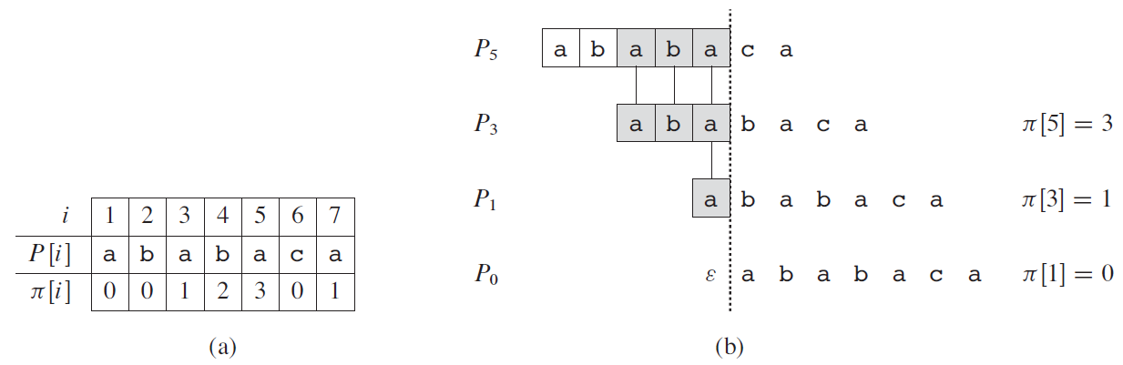
Knuth-Morris-Pratt Algorithm

Slide 31
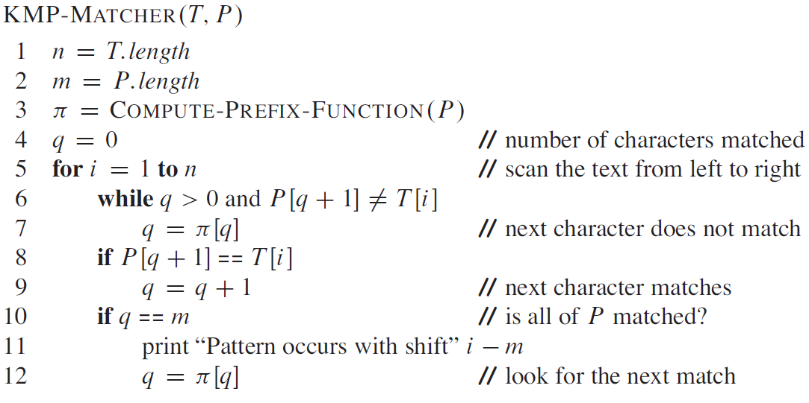
Knuth-Morris-Pratt Algorithm

Slide 32
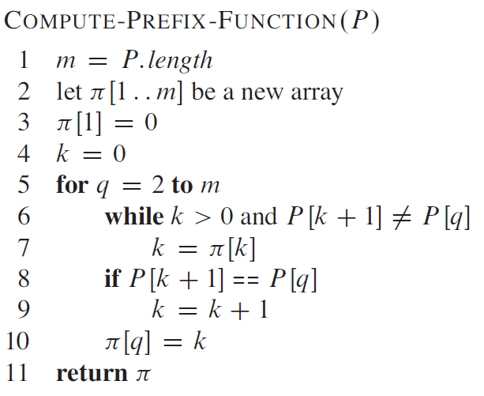
Knuth-Morris-Pratt Algorithm

Slide 33
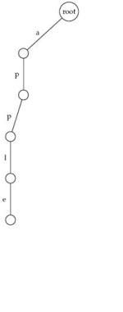
Keyword Trees: Example
Keyword tree:
  Apple

Slide 34
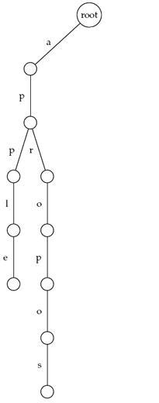
Keyword Trees: Example (cont’d)
Keyword tree:
  Apple
  Apropos

Slide 35
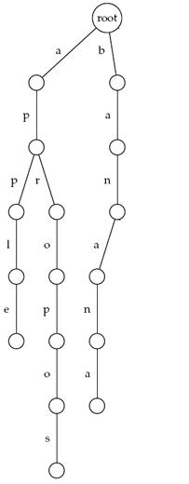
Keyword Trees: Example (cont’d)
Keyword tree:
  Apple
  Apropos
  Banana

Slide 36
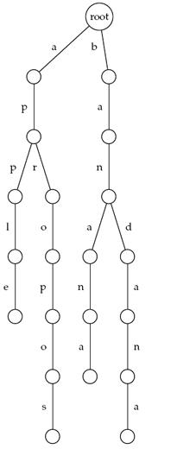
Keyword Trees: Example (cont’d)
Keyword tree:
  Apple
  Apropos
  Banana
  Bandana

Slide 37
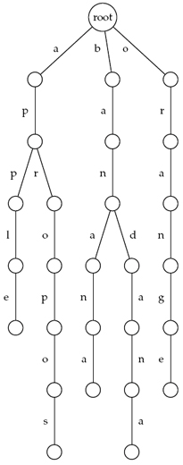
Keyword Trees: Example (cont’d)
Keyword tree:
  Apple
  Apropos
  Banana
  Bandana
  Orange

Slide 38
Keyword Trees: Properties
  Stores a set of keywords in a rooted labeled tree
  Each edge labeled with a letter from an alphabet
  Any two edges coming out of the same vertex have distinct labels
  Every keyword stored can be spelled on a path from root to some leaf

Slide 39
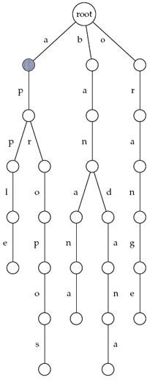
Keyword Trees: Threading (cont’d)
Thread “appeal”
  appeal

Slide 40
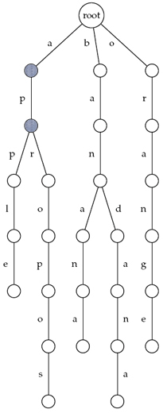
Keyword Trees: Threading (cont’d)
Thread “appeal”
  appeal

Slide 41
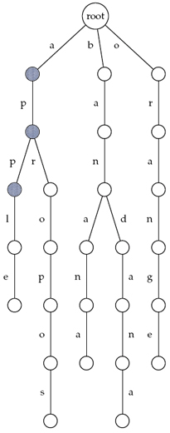
Keyword Trees: Threading (cont’d)
Thread “appeal”
  appeal

Slide 42
Keyword Trees: Threading (cont’d)
Thread “appeal”
  appeal

Slide 43
Keyword Trees: Threading (cont’d)
Thread “apple”
  apple

Slide 44
Keyword Trees: Threading (cont’d)
Thread “apple”
  apple

Slide 45
Keyword Trees: Threading (cont’d)
Thread “apple”
  apple

Slide 46
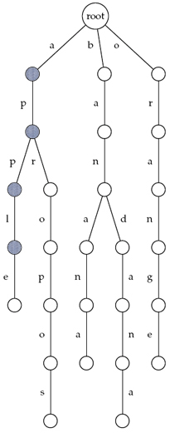
Keyword Trees: Threading (cont’d)
Thread “apple”
  apple

Slide 47
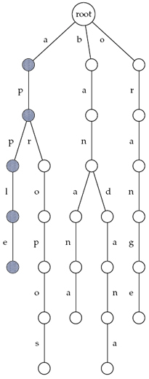
Keyword Trees: Threading (cont’d)
Thread “apple”
  apple

Slide 48
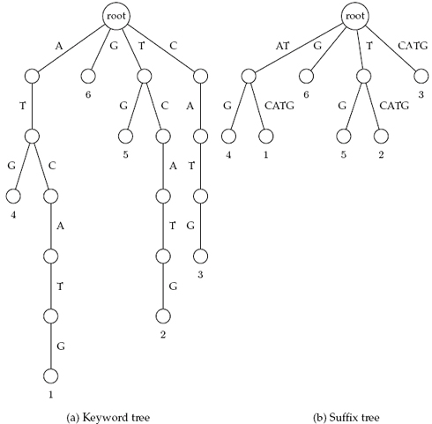
Suffix Trees=Collapsed Keyword Trees
Similar to keyword trees, except edges that form paths are collapsed
  Each edge is labeled with a substring of a text
  All internal nodes have at least two outgoing edges
  Leaves labeled by the index of the pattern.

Slide 49
Suffix Tree of a Text
Suffix trees of a text is constructed for all its suffixes
ATCATG
TCATG
CATG
ATG
TG
G
Keyword
Tree
Suffix
Tree

Slide 50
Suffix Tree of a Text
Suffix trees of a text is constructed for all its suffixes
ATCATG
TCATG
CATG
ATG
TG
G
Keyword
Tree
Suffix
Tree
How much time does it take?

Slide 51
Suffix Tree of a Text
Suffix trees of a text is constructed for all its suffixes
ATCATG
TCATG
CATG
ATG
TG
G
Keyword
Tree
Suffix
Tree
quadratic
Time is linear in the total size of all suffixes, i.e., it is quadratic in the length of the text

Slide 52
Suffix Trees: Advantages
Suffix trees of a text is constructed for all its suffixes
Suffix trees build faster than keyword trees
ATCATG
TCATG
CATG
ATG
TG
G
Keyword
Tree
Suffix
Tree
quadratic
linear (Weiner suffix tree algorithm)

Slide 53
Use of Suffix Trees
Suffix trees hold all suffixes of a text
  i.e., ATCGC: ATCGC, TCGC, CGC, GC, C
  Builds in O(m) time for text of length m
To find any pattern of length n in a text:
  Build suffix tree for text
  Thread the pattern through the suffix tree
  Can find pattern in text in O(n) time!
O(n + m) time for “Pattern Matching Problem”
  Build suffix tree and lookup pattern

Slide 54
Pattern Matching with Suffix Trees
SuffixTreePatternMatching(p,t)
Build suffix tree for text t
Thread pattern p through suffix tree
if threading is complete
output positions of all p-matching leaves in the tree
else
output “Pattern does not appear in text”

Slide 55
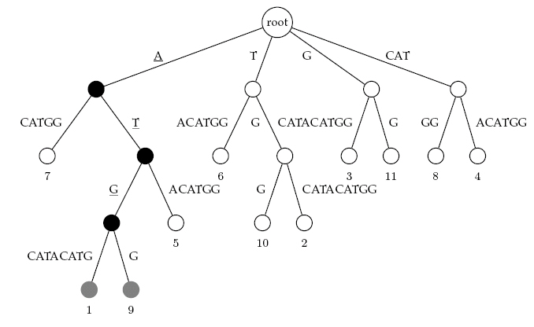
Threading ATG through a Suffix Tree

Slide 56
Suffix Array
More space efficient than suffix tree
  Suffix tree index for human genome is about 47GB
Lexicographically sort all the suffixes
Store the starting indices of the suffixes along with the original string

Slide 57
Suffix Array
ATCATG
1 | ATCATG$
2 | TCATG$
3 | CATG$
4 | ATG$
5 | TG$
6 | G$
7 | $
7 | $
1 | ATCATG$
4 | ATG$
3 | CATG$
6 | G$
2 | TCATG$
5 | TG$
7 | $
1 | ATCATG$
4 | ATG$
3 | CATG$
6 | G$
2 | TCATG$
5 | TG$
Sort the suffixes
lexicographically

Slide 58
Suffix Array
There exists algorithms to construct suffix array in O(n) time
Searching is done using binary search
  Basic binary search would take O(mlogn)
  Can be done in O(m+logn)

Slide 59
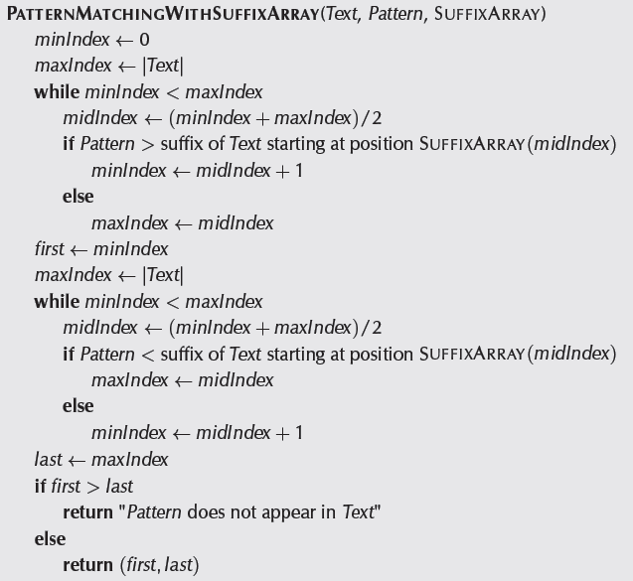

Slide 60
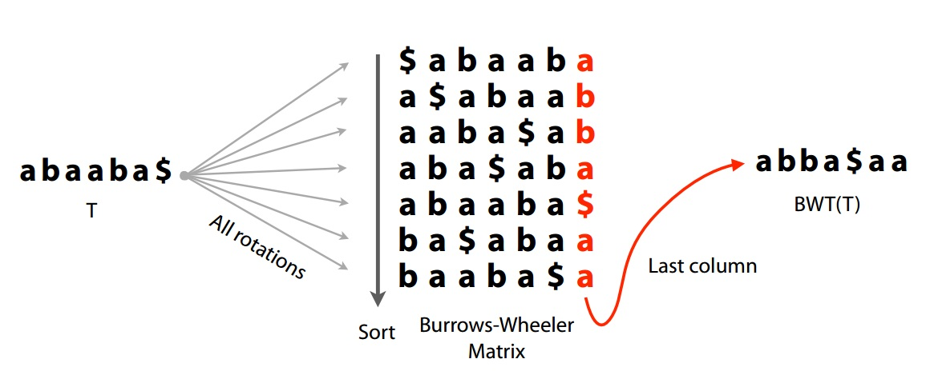
Burrows-Wheeler Transform (BWT)
Lexicographically sort all the rotations
Figure from slide by Ben Langmead

Slide 61
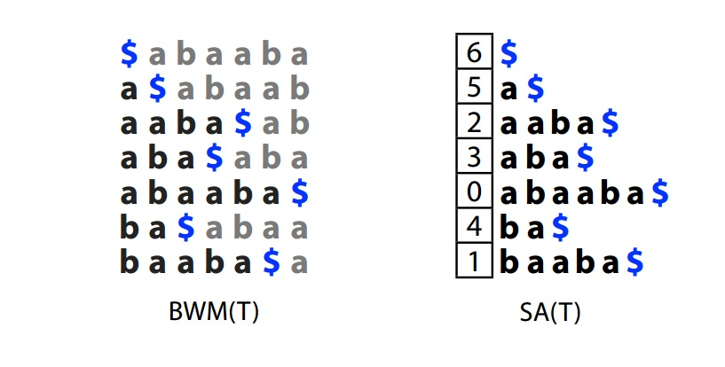
Burrows-Wheeler Transform (BWT)
Sort order is the same for rotations and suffixes
  Since $ precedes others
Figure from slide by Ben Langmead

Slide 62
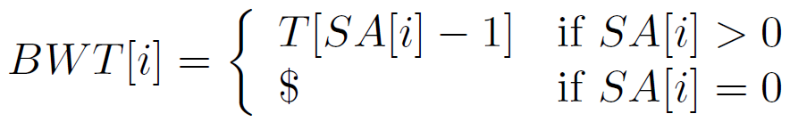
Burrows-Wheeler Transform (BWT)

Slide 63
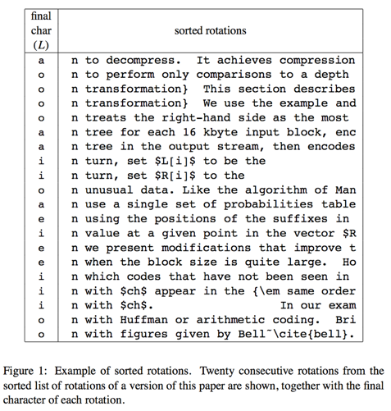
Burrows-Wheeler Transform (BWT)
Original motivation was compression
Rotating and sorting tend to increase run lengths
Figure from original paper on BWT

Slide 64
LF mapping
Last to first mapping
$ a b a a b a
a $ a b a a b
a a b a $ a b
a b a $ a b a
a b a a b a $
b a $ a b a a
b a a b a $ a

Slide 65
LF mapping
Assign numbers to distinguish characters
  a b₀ a a b₁ a $
$ a b a a b a
a $ a b a a b₁
a a b a $ a b₀
a b a $ a b a
a b a a b a $
b₁ a $ a b a a
b₀ a a b a $ a

Slide 66
LF mapping
They will be in same order in L and F. Why?
  a b₁ a a b₂ a $
$ a b a a b a
a $ a b a a b₁
a a b a $ a b₀
a b a $ a b a
a b a a b a $
b₁ a $ a b a a
b₀ a a b a $ a

Slide 67
LF mapping
Assign numbers to distinguish characters
  a₀ b₀ a₁ a₂ b₁ a₃ $
$ a b a a b a₃
a₃ $ a b a a b₁
a₁ a b a $ a b₀
a₂ b a $ a b a₁
a₀ b a a b a $
b₁ a $ a b a a₂
b₀ a a b a $ a₀

Slide 68
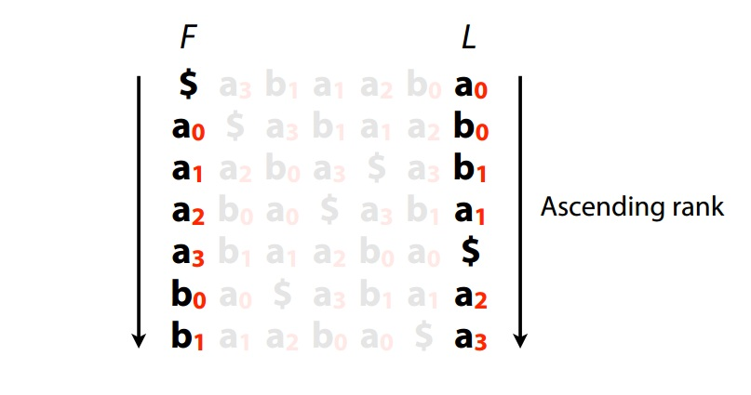
LF mapping
Figure from slide by Ben Langmead

Slide 69
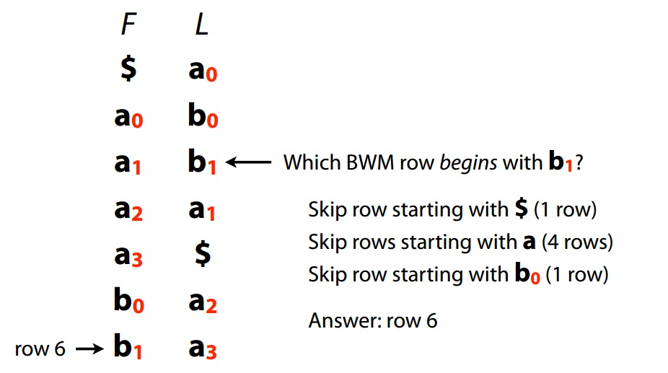
LF mapping
Figure from slide by Ben Langmead

Slide 70
BWT reversing
Reverse BWT from right to left
$ a₀
a₀ b₀
a₁ b₁
a₂ a₁
a₃ $
b₀ a₂
b₁ a₃
a₃b₁a₁a₂b₀a₀$

Slide 71
BWT reversing
Reverse BWT from right to left
$ a
a b
a b
a a
a $
b a
b a
abaaba$

Slide 72
FM index
FM index
  Combines the BWT with a few small auxiliary data structures
  Ferragina and Manzini
F and L from BWT
  Both can be compressed

Slide 73
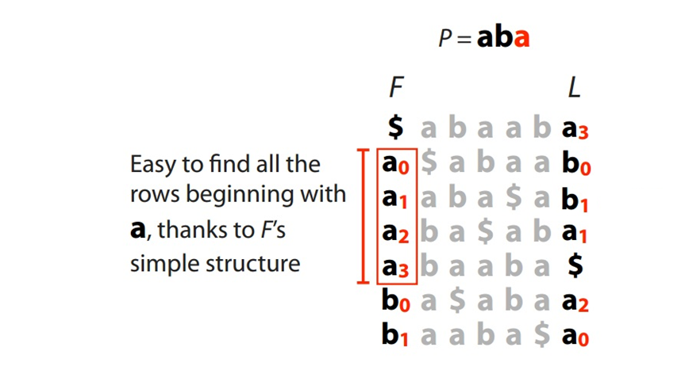
FM index querying
Figure from slide by Ben Langmead

Slide 74
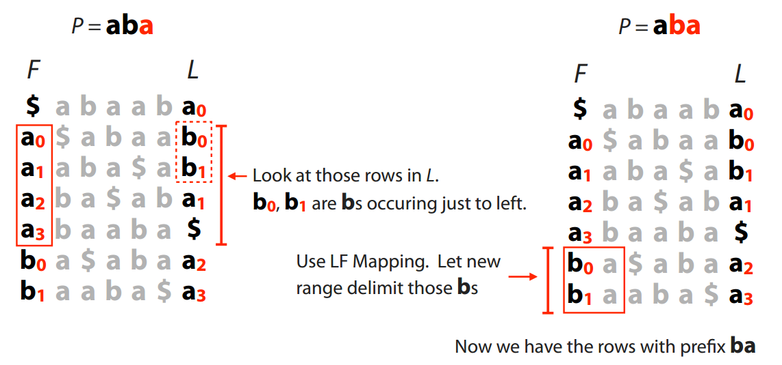
FM index querying
Figure from slide by Ben Langmead

Slide 75
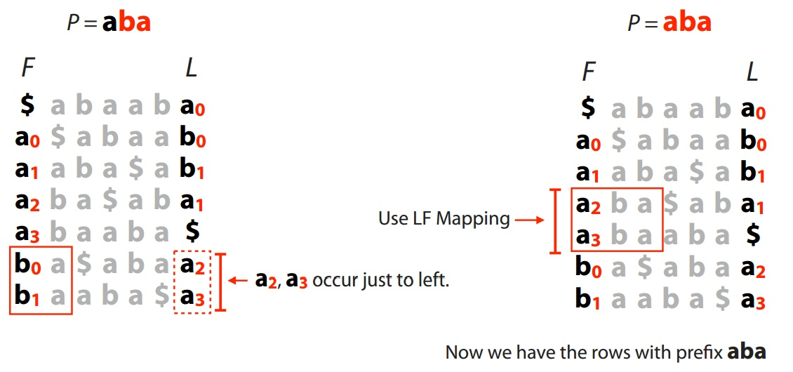
FM index querying
Figure from slide by Ben Langmead

Slide 76
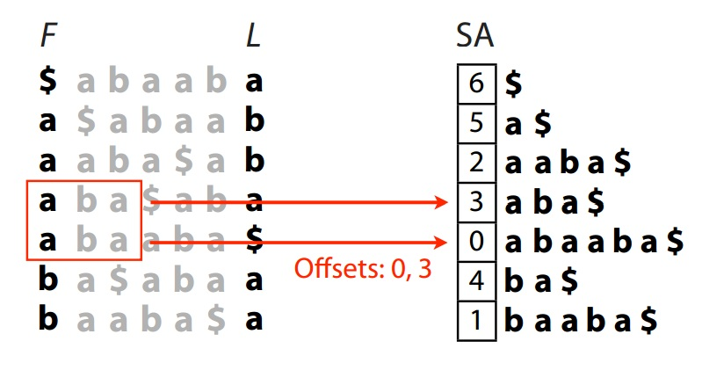
FM index issues
Where are the matches?
  Store positions as in suffix array
Figure from slide by Ben Langmead

Slide 77
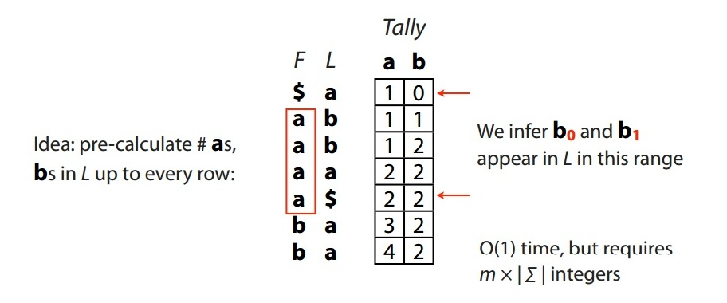
FM index issues
How to get numbers (ranks) for LF mapping?
  Calculate numbers of each character up to that row
Figure from slide by Ben Langmead

Slide 78
FM index
FM index for human genome can be as small as 1.5 GB
  With some space-time tradeoff

Slide 79
References
Suffix Tree
  Bioinformatics Algorithms (Part II) - Chapter 9
  Part I of Algorithms on Strings, Trees and Sequences by Dan Gusfield
BWT, FM index
  http://www.cs.jhu.edu/~langmea/resources/bwt_fm.pdf

